Slide 1

Introduction to Cyber Security
Ritesh Dhanare
Assistant Professor
Information technology Department

Slide 2
Table of Contents
Threats
Goals of security
NSTISSC security

Slide 3
Threats
Snooping, the unauthorized interception of information, is a form of disclosure. It is passive, suggesting simply that some entity is listening to (or reading) communications or browsing through files or system information.
Modification or alteration, an unauthorized change of information, covers three classes of threats. The goal may be deception, in which some entity relies on the modified data to determine which action to take, or in which incorrect information is accepted as correct and is released.

Slide 4
Threats
Masquerading or spoofing, an impersonation of one entity by another, is a form of both deception and usurpation. It lures a victim into believing that the entity with which it is communicating is a different entity.
Repudiation of origin, a false denial that an entity sent (or created) something, is a form of deception.
Denial of receipt, a false denial that an entity received some information or message, is a form of deception.

Slide 5
Threats
Delay, a temporary inhibition of a service, is a form of usurpation, although it can play a supporting role in deception.
Denial of service, a long-term inhibition of service, is a form of usurpation, although it is often used with other mechanisms to deceive.

Slide 6
Goals of security
Prevention means that an attack will fail.
Detection is most useful when an attack cannot be prevented, but it can also indicate the effectiveness of preventative measures.
Recovery has two forms. The first is to stop an attack and to assess and repair any damage caused by that attack

Slide 7
NSTISSC/CNSS security
National Standard of Training for Information Systems Security Co
Committee on National Security Systems

Slide 8
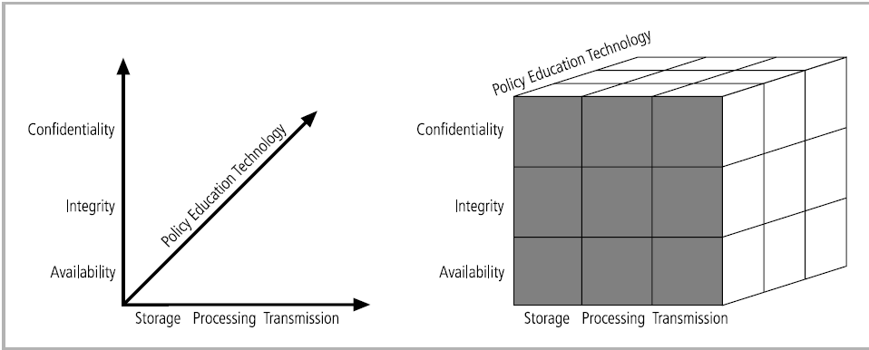
NSTISSC security

Slide 9
NSTISSC security
For example, the intersection between technology, integrity, and storage requires a control or safeguard that addresses the need to use technology to protect the integrity of information while in storage.

